Slide 1
Product Innovation – ‘Press or Die’
Re-design Die Cast or Extruded Parts to Stamped Parts

Slide 2
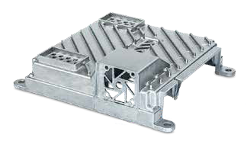
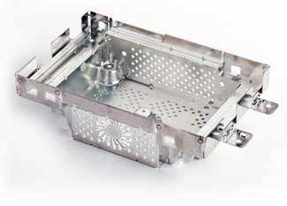
Press or Die
One of our customers recently approached us with a casting and asked if we could manufacture a stamped equivalent.
Our technical team love a challenge and delivered a fantastic alternative. Several benefits to changing are: Weight Saving, Tool Life Increase, Positive Environmental Impact & of course Cost Savings.
From a CAD file, we can redesign a part to a pressed equivalent to achieve the same output as the casting although visually it may look completely different.
SO WHY CHANGE?
While casting has the ability to produce quality parts in certain situations, for many cases, stamping offers adjustable production processes, faster production, and a variety of other advantages.

Slide 3
Cost-Effective
Cost Lower cost per volume, faster production, less scrap material.
Production Production rates up to 1000 parts per minute on small presses & 60 parts per minute on larger machines.
Energy Press manufacturing can be up to 75% more energy efficient against that of the cast manufacturing process.
Labour With stamping you have the ability to produce a finish part with no 2nd operation or machining required to achieve the required tolerances.
Tooling Life Press tools will last 5,000,000 shots in comparison to cast which will last 100,000 before replacement or maintenance is required.
Although we are tied to an NDA, we took a £32 casting and successfully redesigned to a £7.50 pressed part.

Slide 4
Efficiency
Press manufacturing efficiency Press manufacturing can be up to 75% more efficient than that of casting production.
Faster Part Production Press parts can be manufactured in a 10 part to 1 ratio against that of the cast equivalent.
One operation finishing Not always a need for a second operation.
Cost-effectiveness from tooling costs to piece price.
Matched effectiveness.
Environmentally friendly manufacturing.

Slide 5
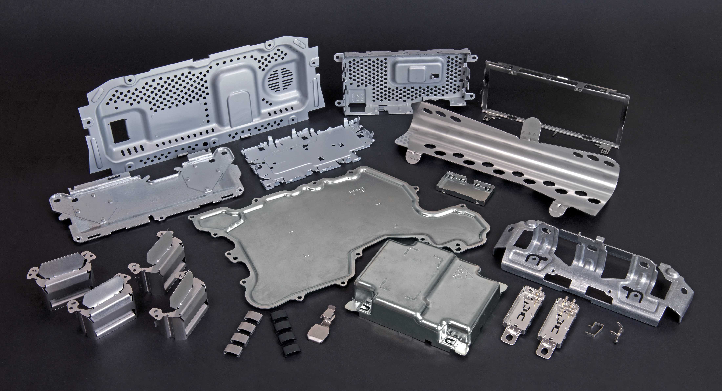
Versatile
In the past, stamping was considered inferior to casting when it came to forming difficult parts. Today, stamping technology has overcome this limitation in many ways.
With intelligent data processing, in-die tooling capabilities, and complex press and tooling, metal stamping operations are well-equipped to produce some of the most intricate, finely-made parts in the industry.

Slide 6
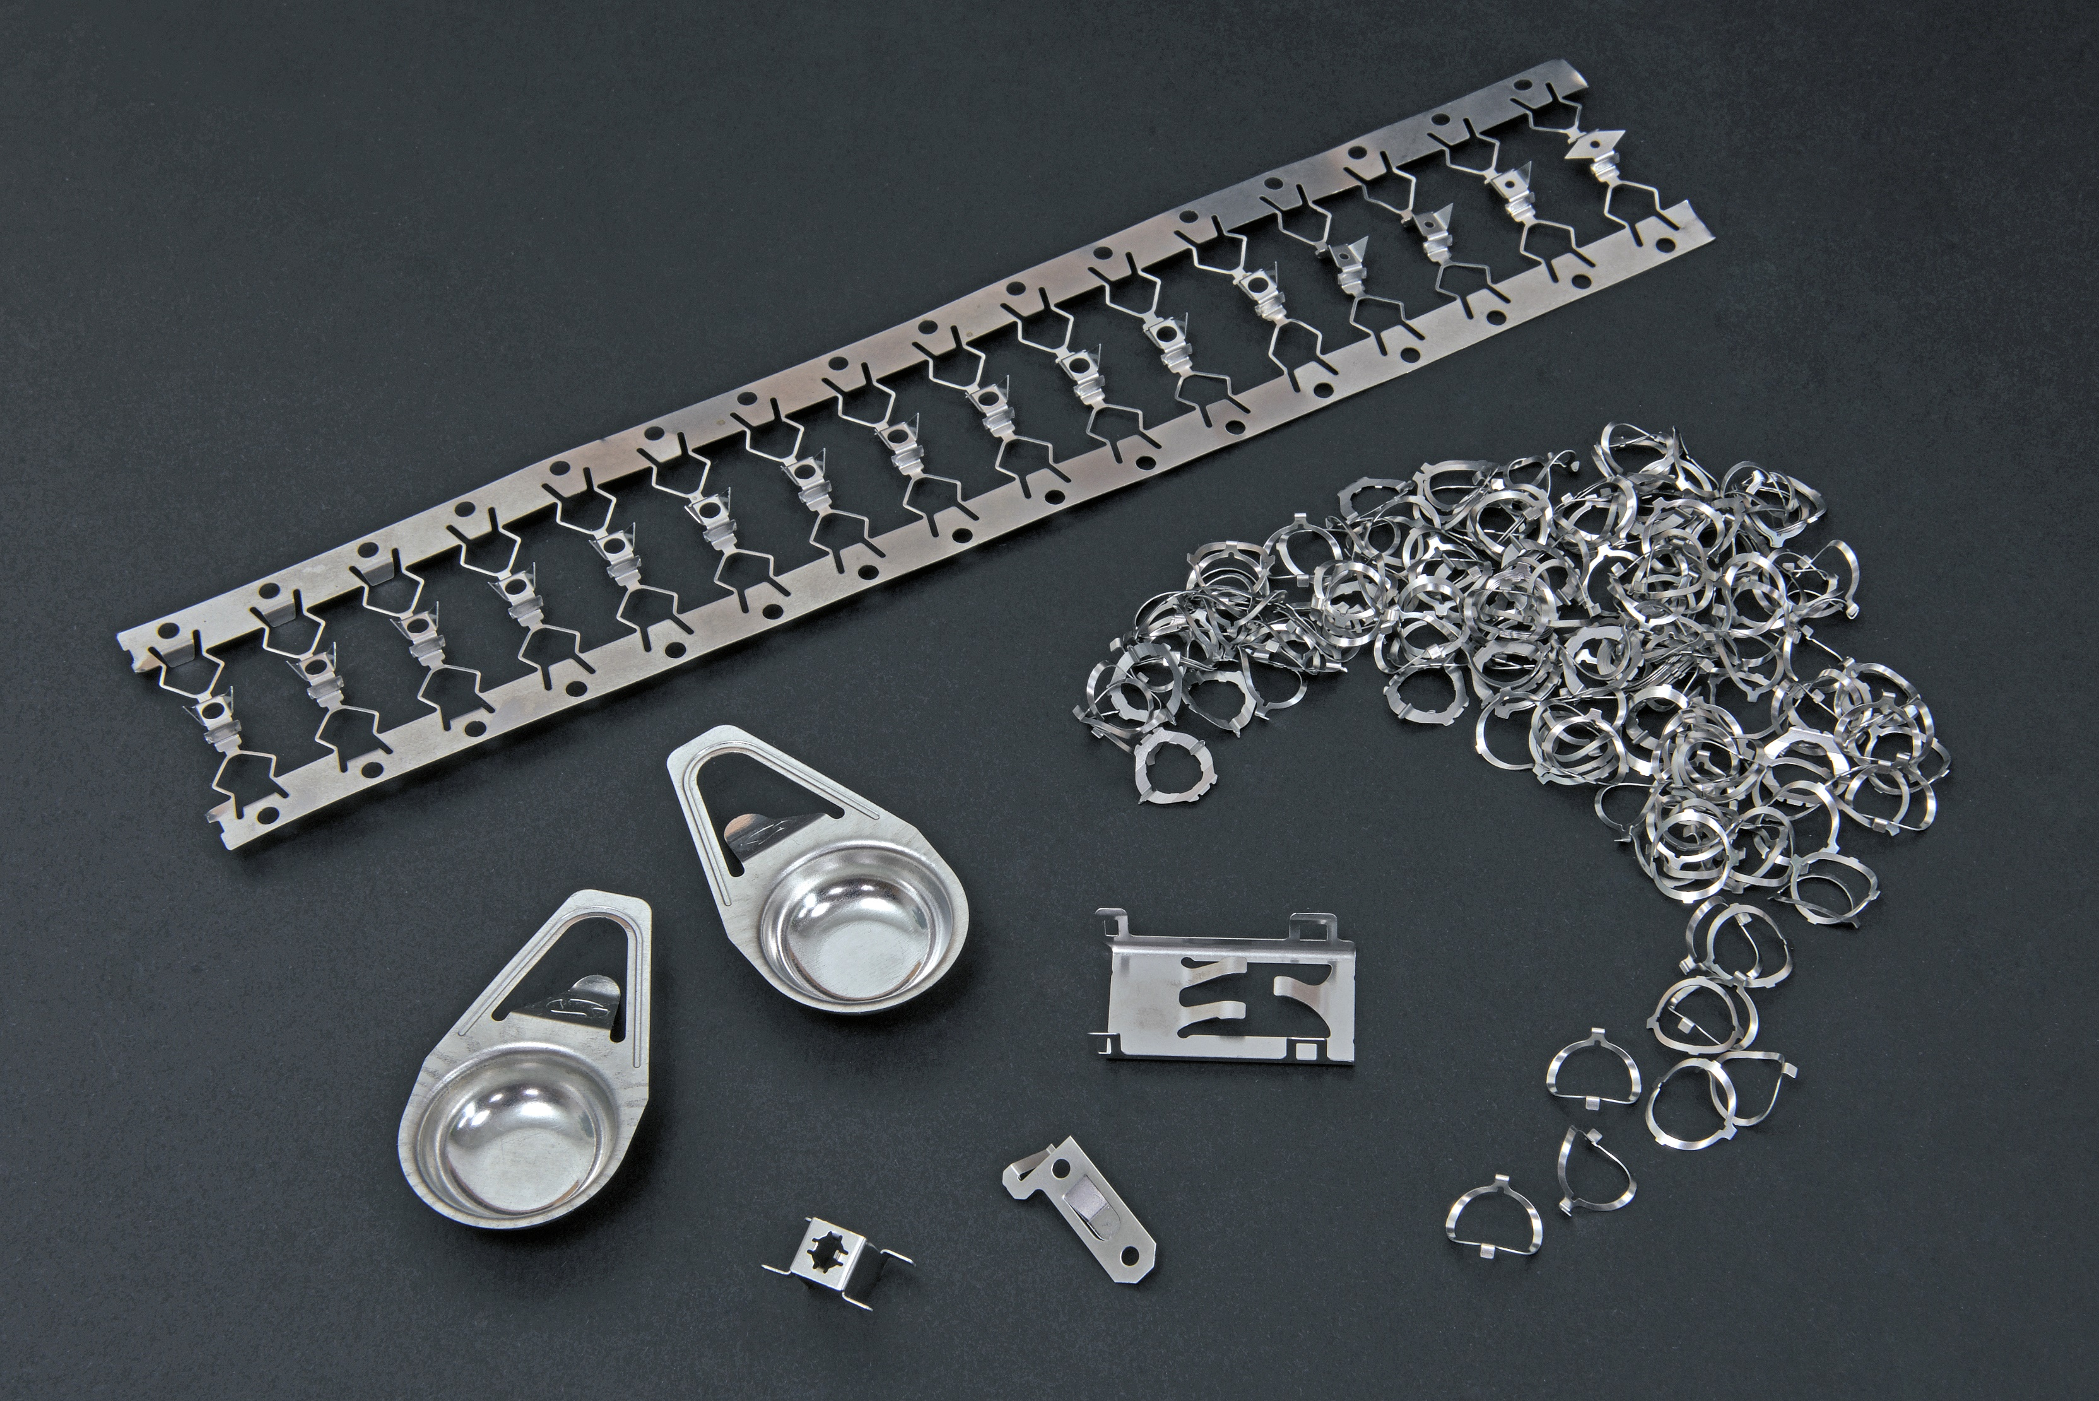
Flexibility & Strength
The pressing process is so much more flexible when it comes to design, the finer details, complex shapes and the overall process:
Pressings are much easier to make alterations to if need be and at far lower cost.
Tooling maintenance is minimal compared to that of a casting.
Lighter components mean cheaper transportation costs.
Parts can be designed to provide the same strengths that a casting would bring.
Finishes and hardness can be achieved through second op processes.

Slide 7
www.clamason.com
Let us review your current cast parts and formulate an alternative solution that could potentially be of massive benefit to your company
Visit our website for more information:

